Slide 1
Minesweeper
CST-247: Enterprise Application Programming III
By: Daniel Cender, Nathaniel Kumar, and Hiram Viezca

Slide 2
Project Objectives
Design and build a .NET N-Layer web application based from the desktop version of the Minesweeper application. The application focuses on:
ASP.NET
C#
.NET MVC
T-SQL
AJAX / client-side HTTP requests
Solid OOP Programming standards

Slide 3
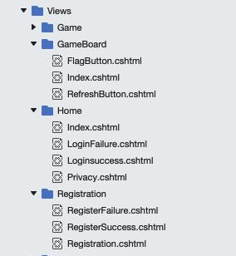
Frontend Design
Bootstrap
HTML
ASP.NET
CSS for theme changer & responsive game board grid

Slide 4
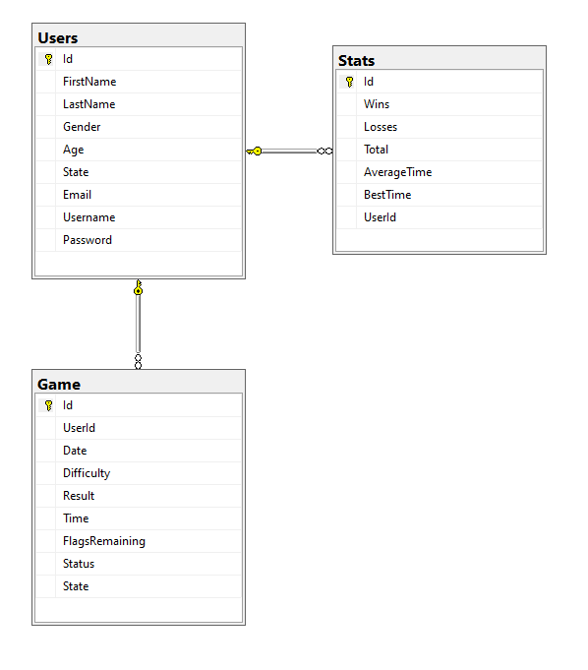
Backend Design
Table Design: Uses 3 Tables
Implemented as an MS SQL database connection in a DAO application class layer.
Controller classes connect to the DAO layer and perform queries or data updates and route users, oftentimes using special Service-layer objects and utilities.
Accesses external web hosted database.
Utilizes common software architecture patterns to keep complexity minimal (DI, IoC, DAO).

Slide 5
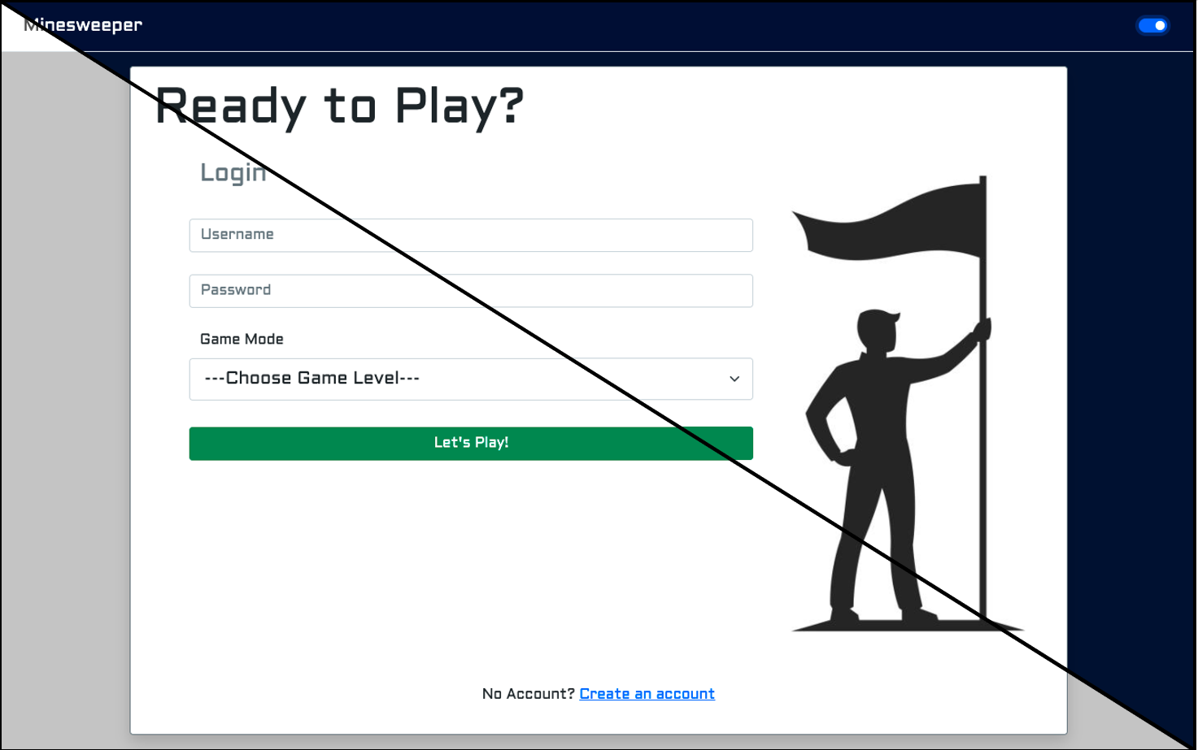
Login Form
Existing users can login to the application using the email and password from their registered account.
If a user does not possess an account, they can navigate to the registration form.
User can change light/dark theme

Slide 6
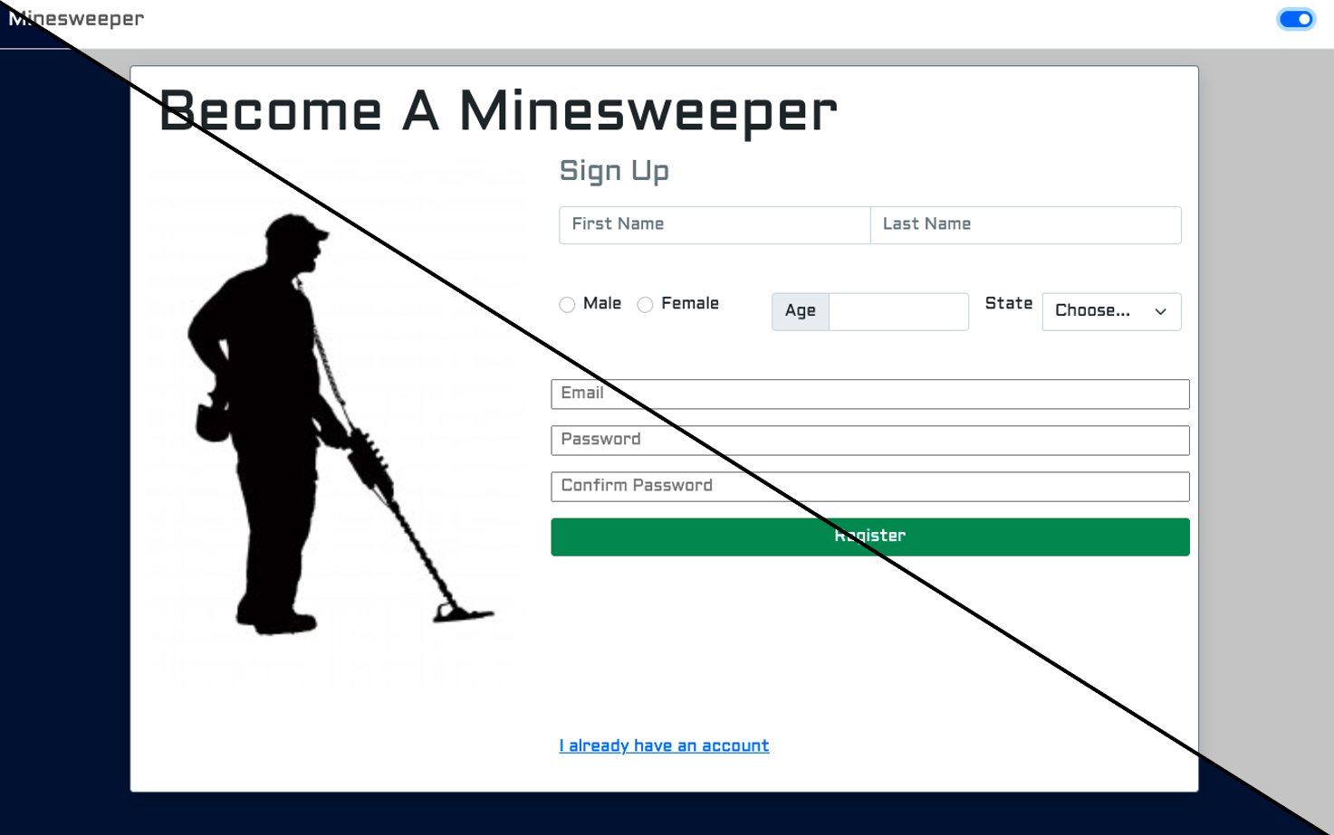
Registration Form
If a user does not already possess an account, they may create one here.
All fields are required for a successful registration.
If a user attempts to register with incorrect or otherwise invalid credentials, the errors will cause the registration attempt to fail and the page will reload.
Light/dark theme changes here as well

Slide 7
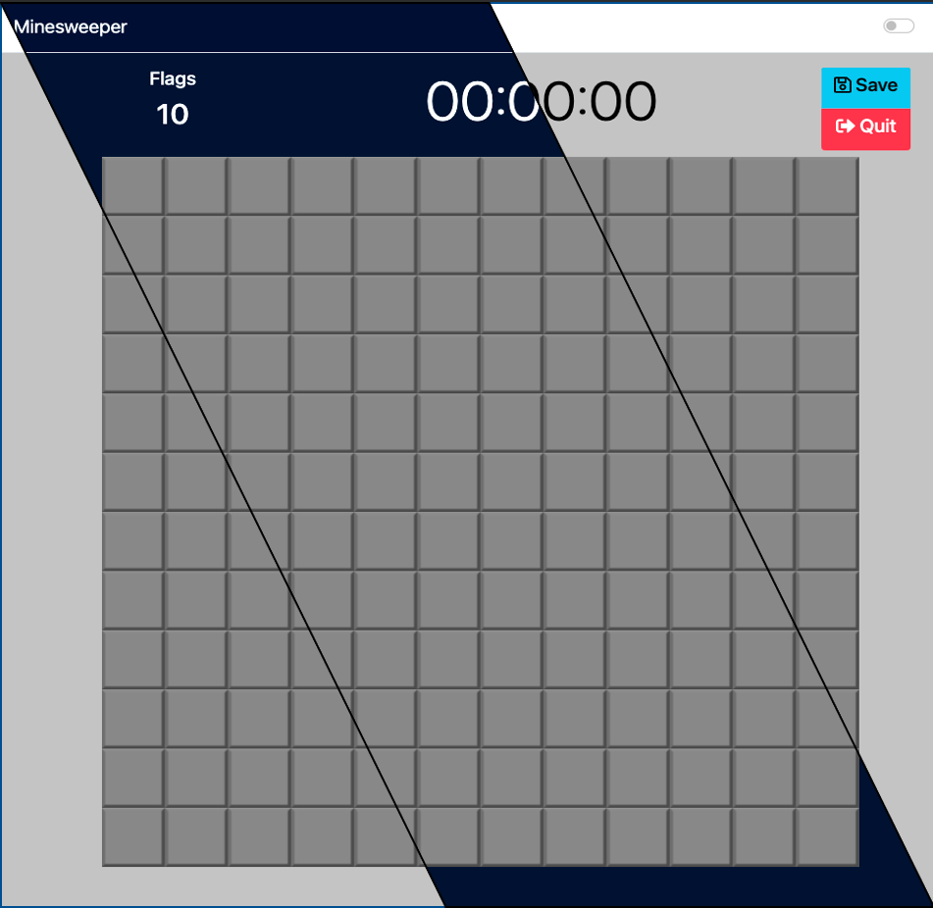
Game Page
Light/dark theme changes here as well
Right-click places/removes a flag on a cell
Left-click attempts to expose a cell

Slide 8
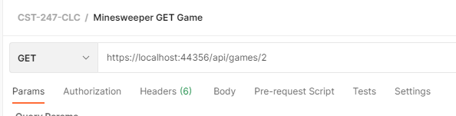
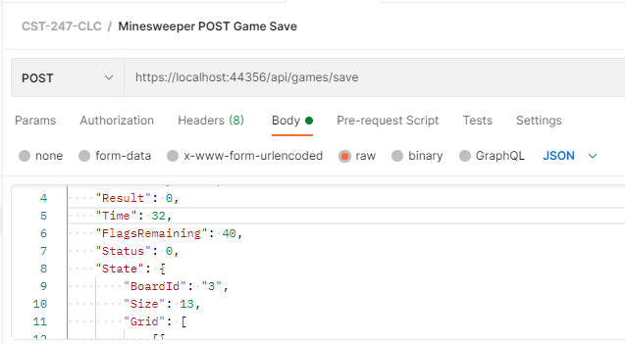
API Routes
/api/games/{id} (GET) - Fetches a game’s metadata from its ID.
/api/games/{id}/save (POST) - Saves a game’s state to the database.

Slide 9
Ideas for Future Improvements
Add a view where users can see their past game runs and how they match up to other similar players.
Add a view showing a user’s accuracy metrics over time.
Add more API routes for interacting with user metrics or user profile settings
Add a view for the users to update their own profile settings, or delete their account.

Slide 10
Limitations / Issues
Does not support remember me, stay signed in, forgot password for login.
Registration could use a verify password to avoid users inputting a password incorrectly the first time.
No “Show” feature on passwords right now, part of user friendliness.

Slide 11
Software Demo
Software Screencast demo and project walkthrough:
(Project Walkthrough): https://www.loom.com/share/6e4da93482b84ff5935675f2a9a061bd
(Slide Deck): https://www.loom.com/share/97d741ca3af5453bab2a839ea10ec482

